Slide 1
Celebrating the Centenary of the United Church of Canada

Slide 2
Mississauga United Churches Joint Service Celebrating the Centenary of the UCC @ Eden United Church Sunday June 8th 2025

Slide 3
Mississauga United Churches United Churches
Applewood United Church (Rev Joanne Hedge)
Eden United Church (Rev Norm Hennig-Pereira)
Erindale United Church (Rev Nicholas Forrester)
Erin Mills United Church (Rev Kathi Phillips)
Christ First United Church
(Rev Heather Weaver-Orosz)
Streetsville United Church (Rev Joe Hopkins)
St. Stephen’s on-the-Hill United Church
(Rev Morar Murray-Hayes)
Sheridan United Church (Rev Eleanor Scarlett)
Westminster United Church (Rev Irene Ty)

Slide 4
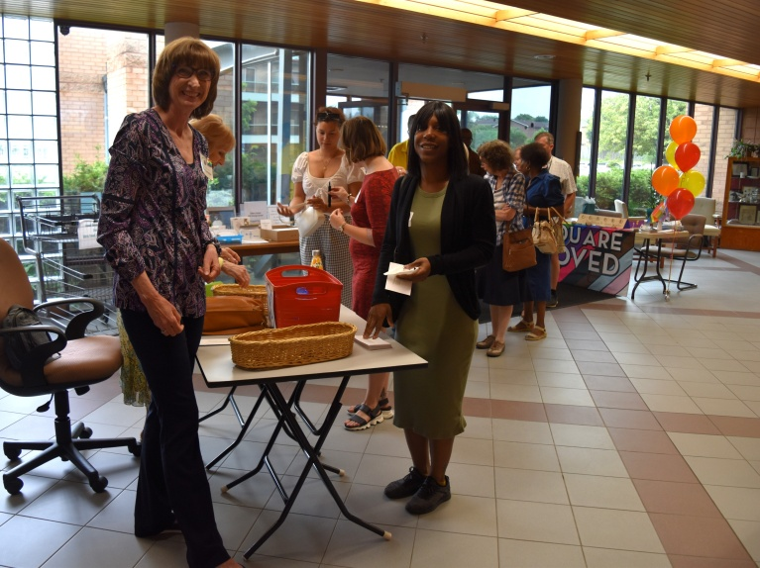
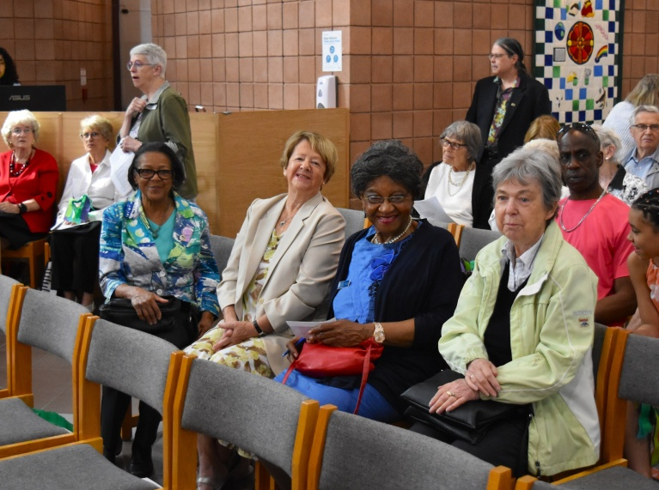
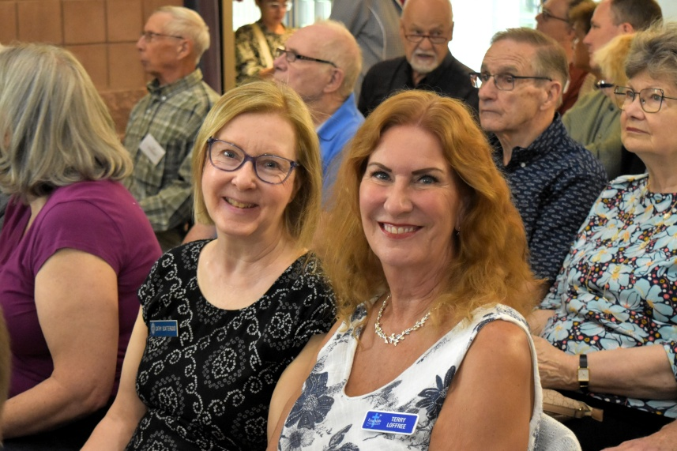
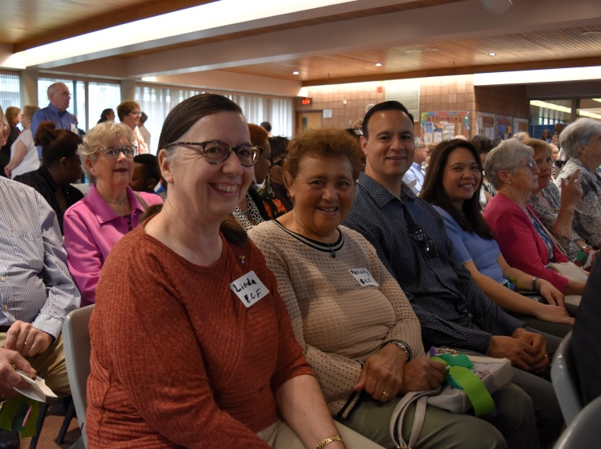
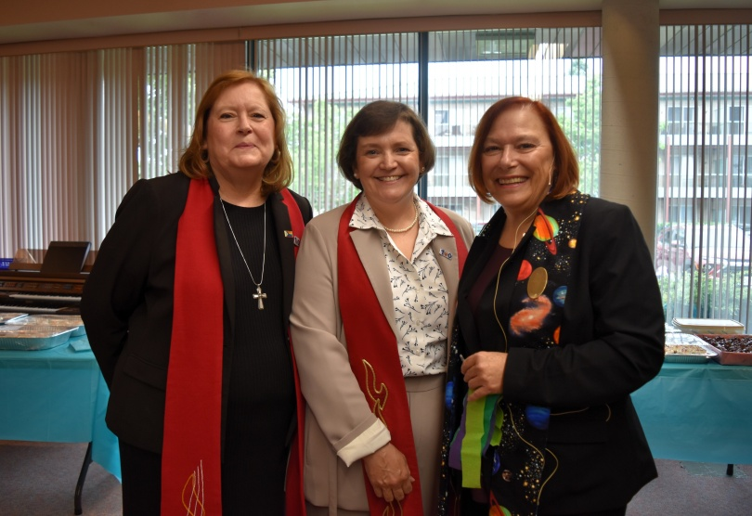
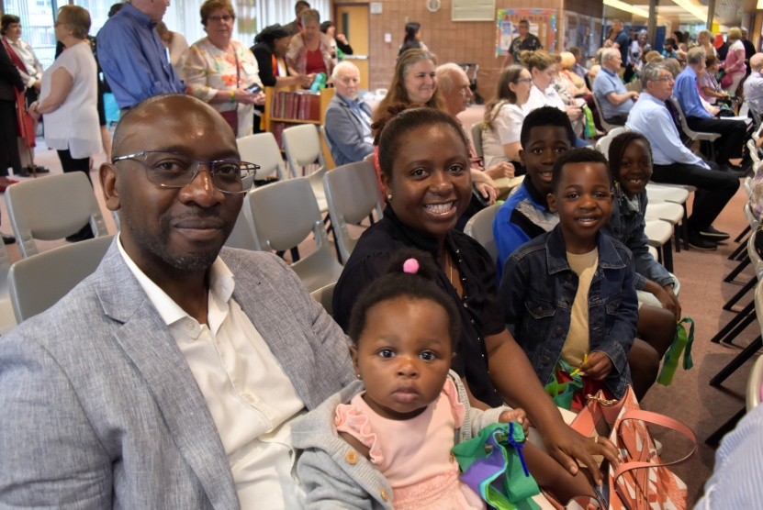
Gathering of Congregants & Participants

Slide 5
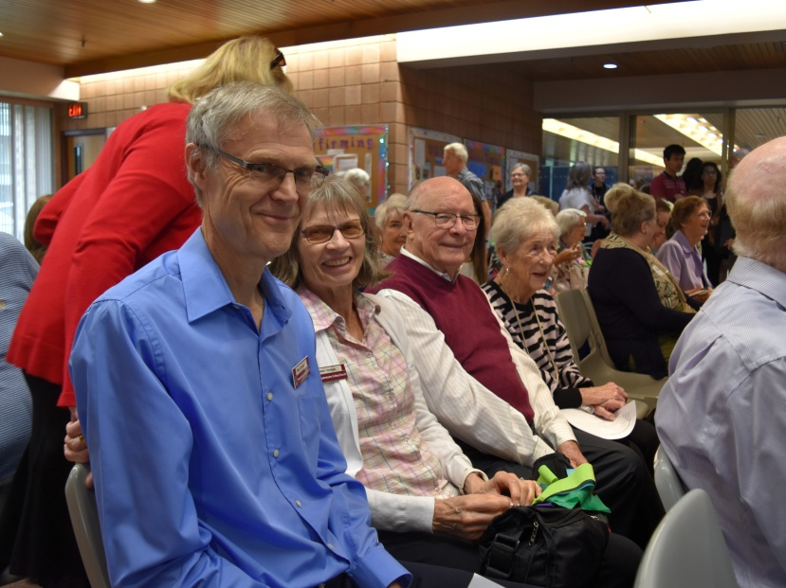
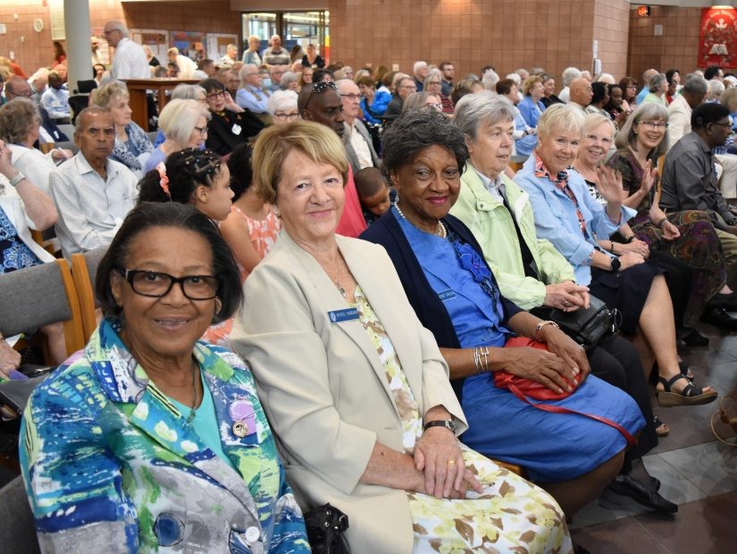
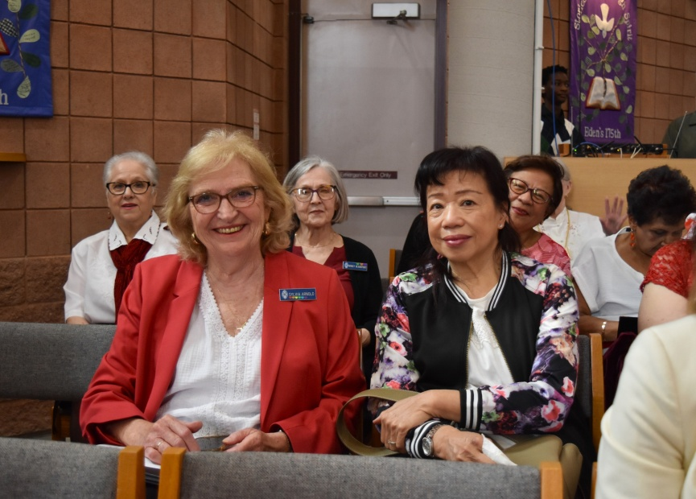
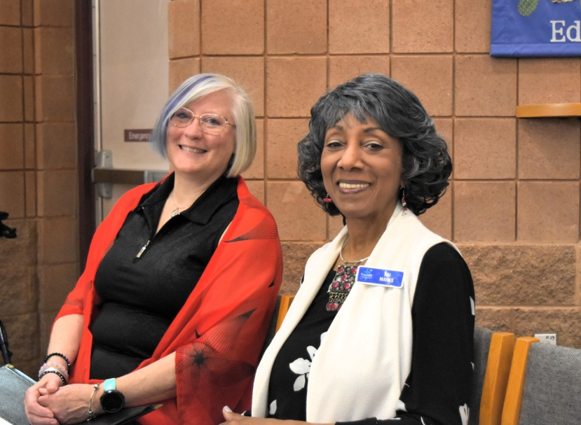
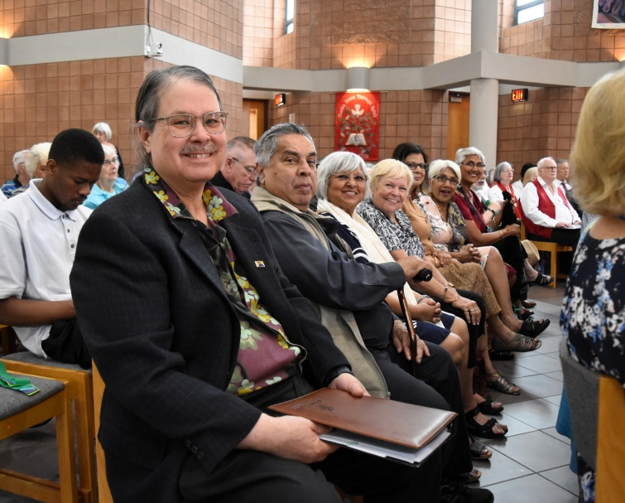
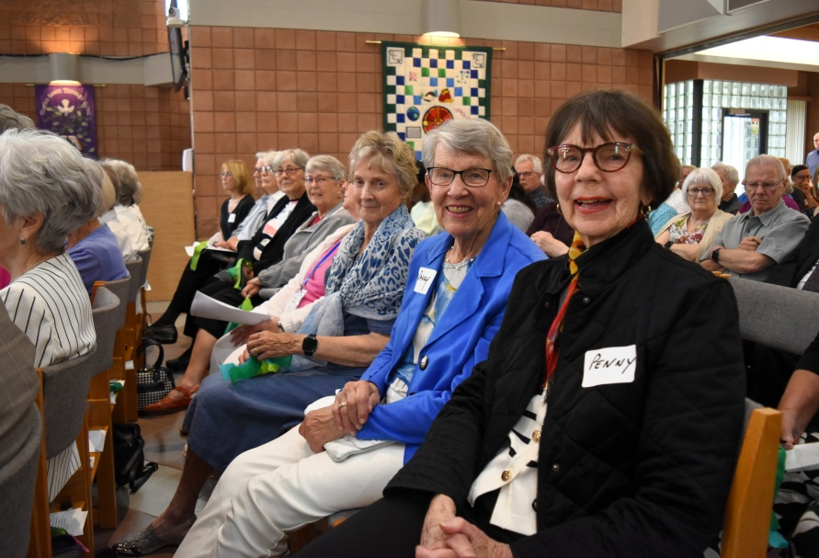

Slide 6
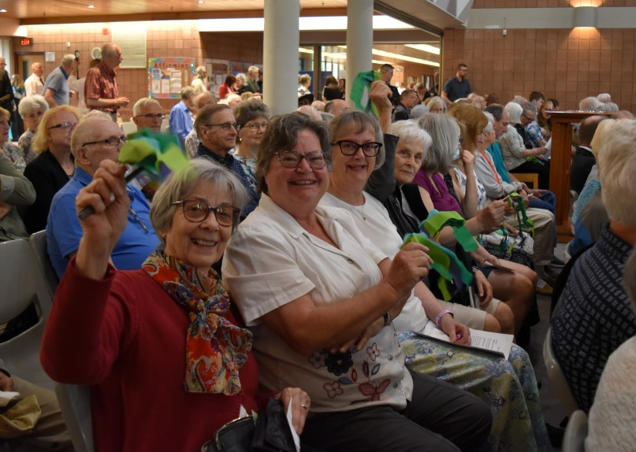
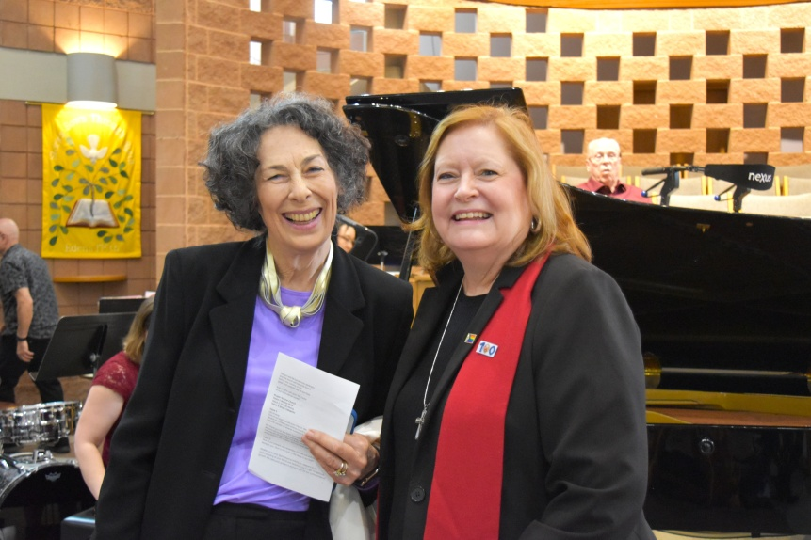
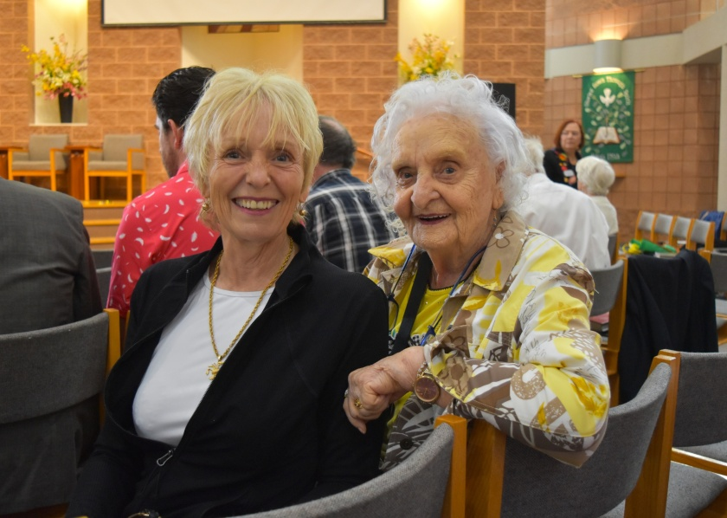
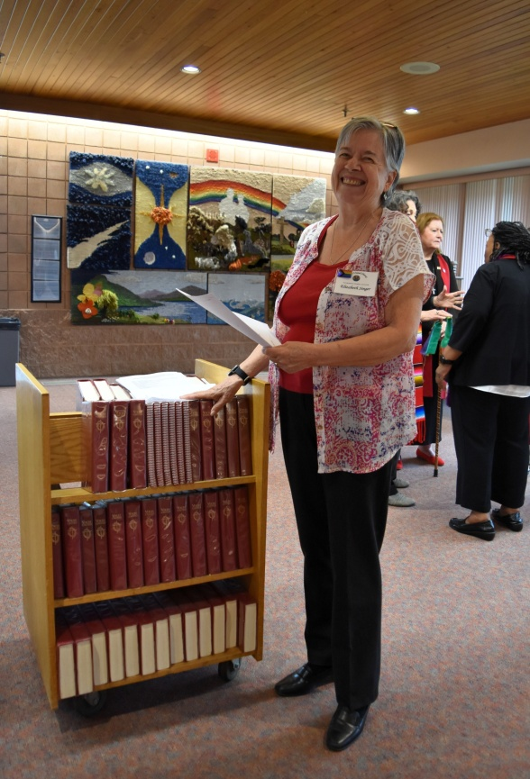
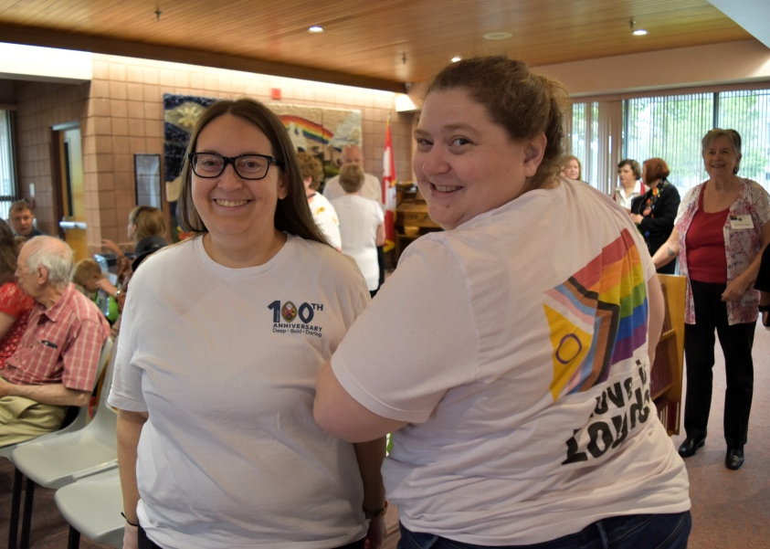
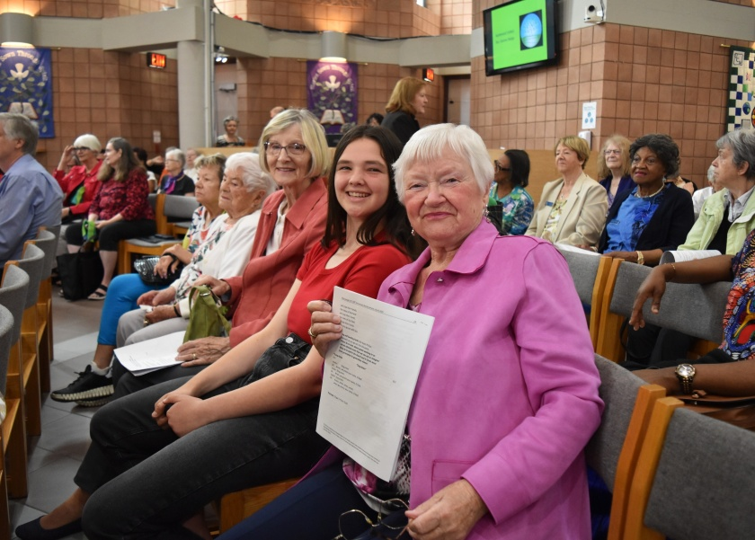

Slide 7
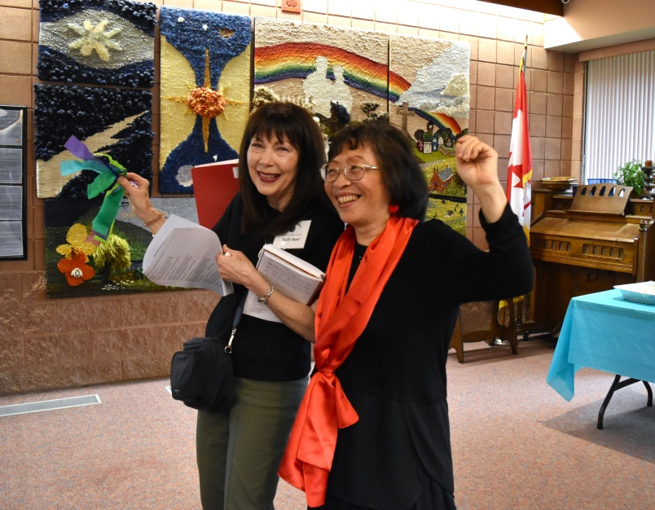
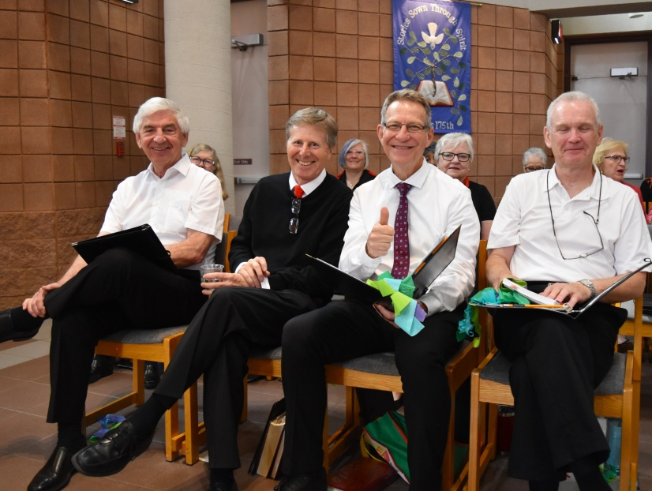
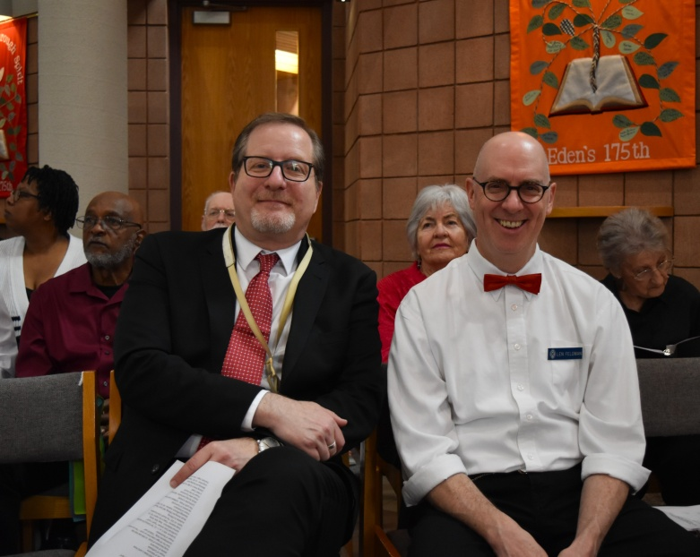
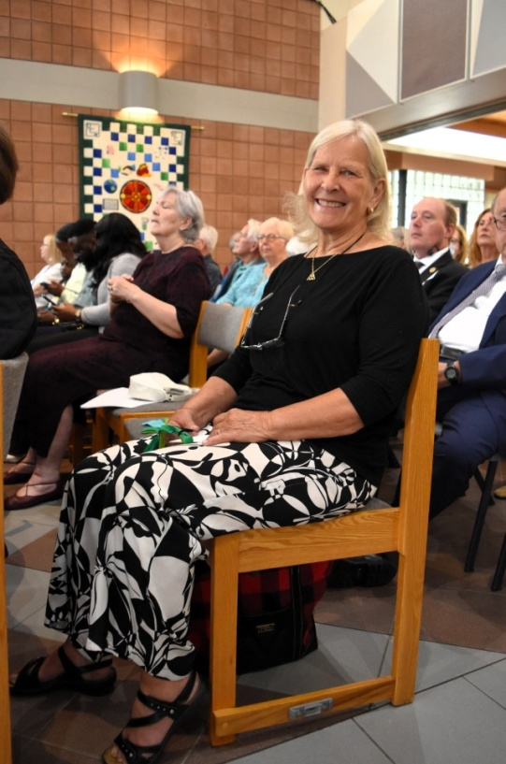
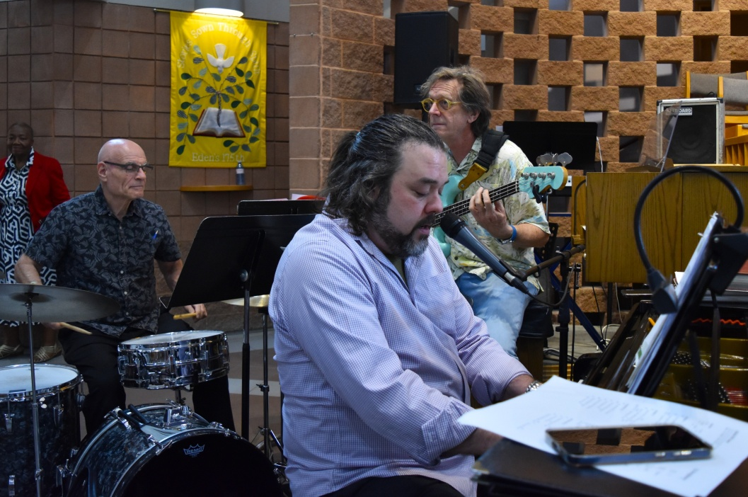
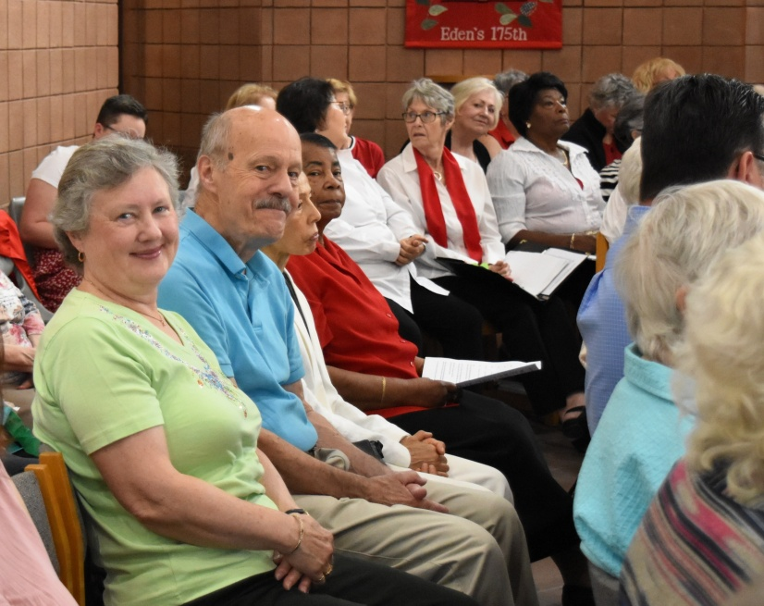

Slide 8
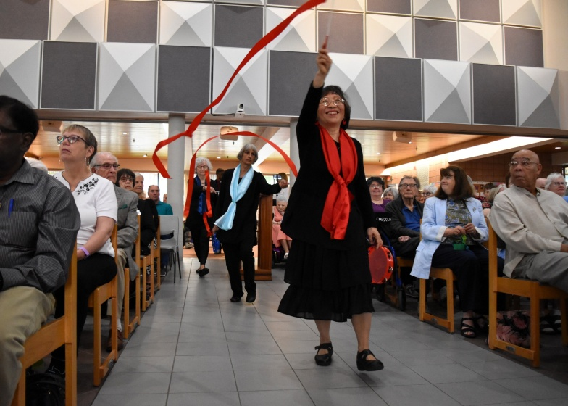
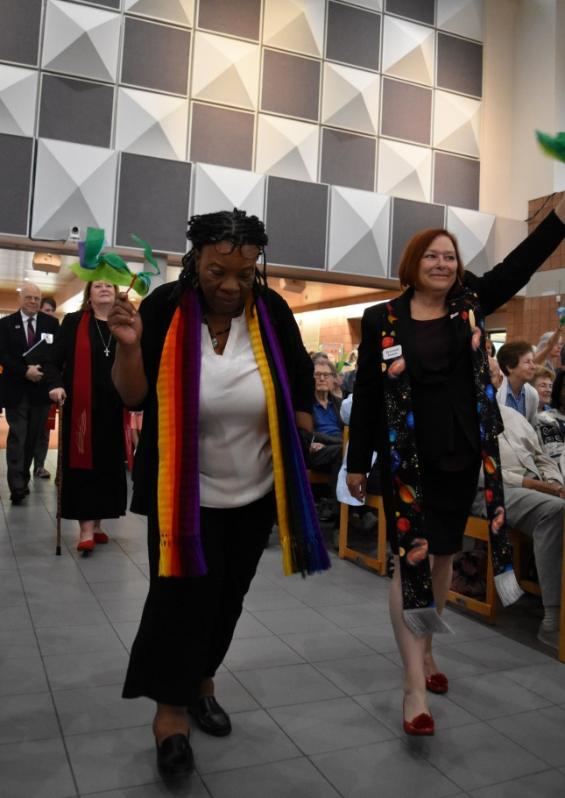
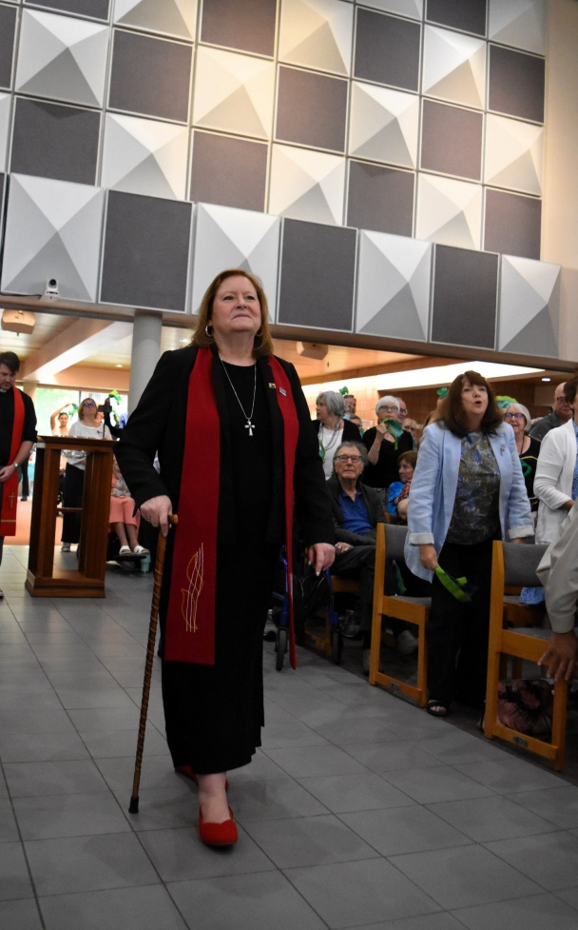
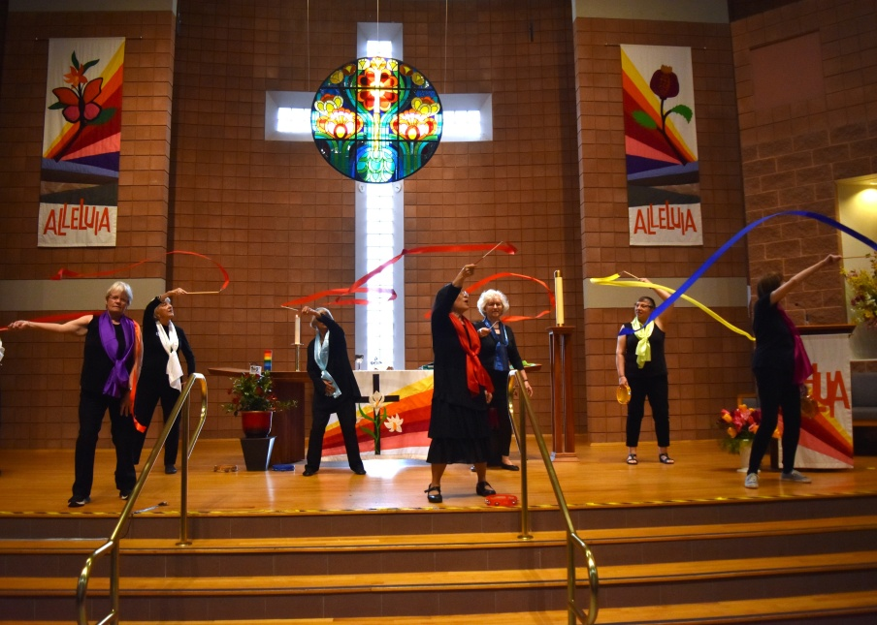
Liturgical Dancing & Procession

Slide 9
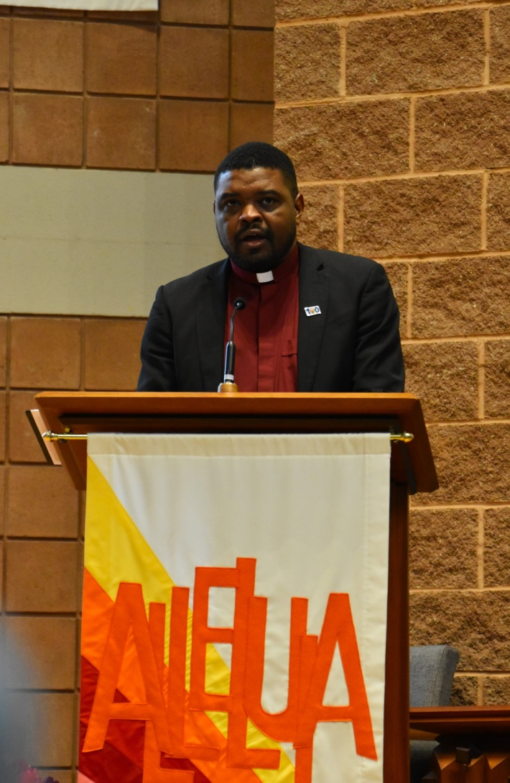
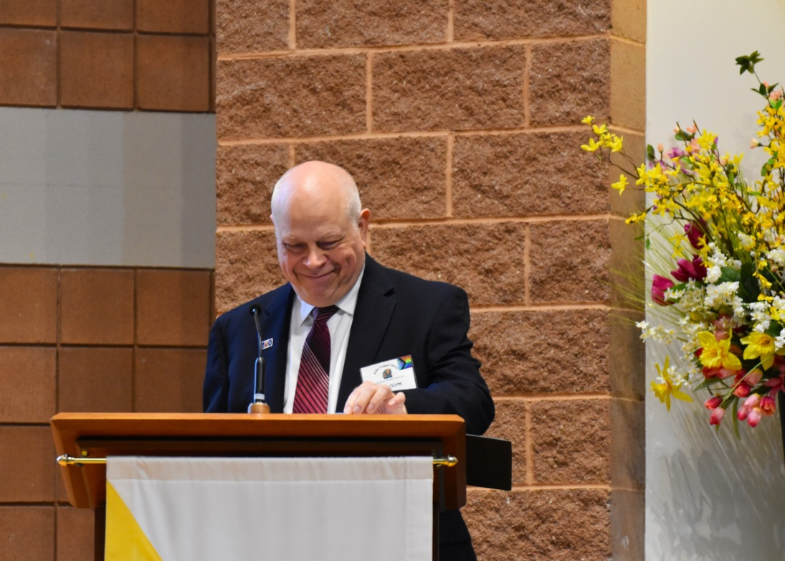
Call to Worship, Welcome & Prayer of Confession Revs Kathi Phillips, Norm Hennig-Pereira & Nicholas Forrester Nicholas Forrester

Slide 10
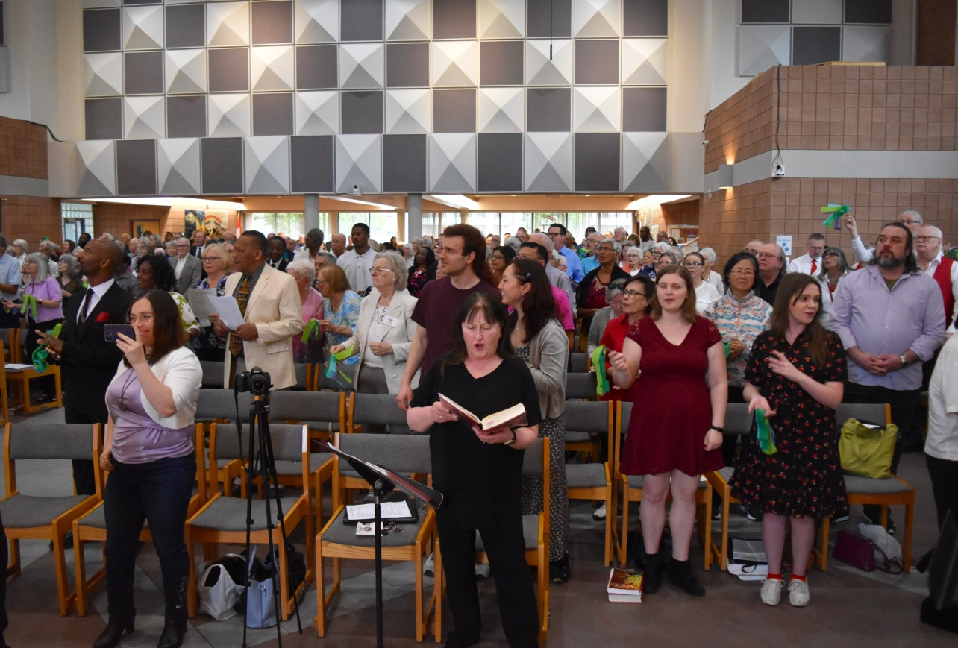
The Congregation

Slide 11
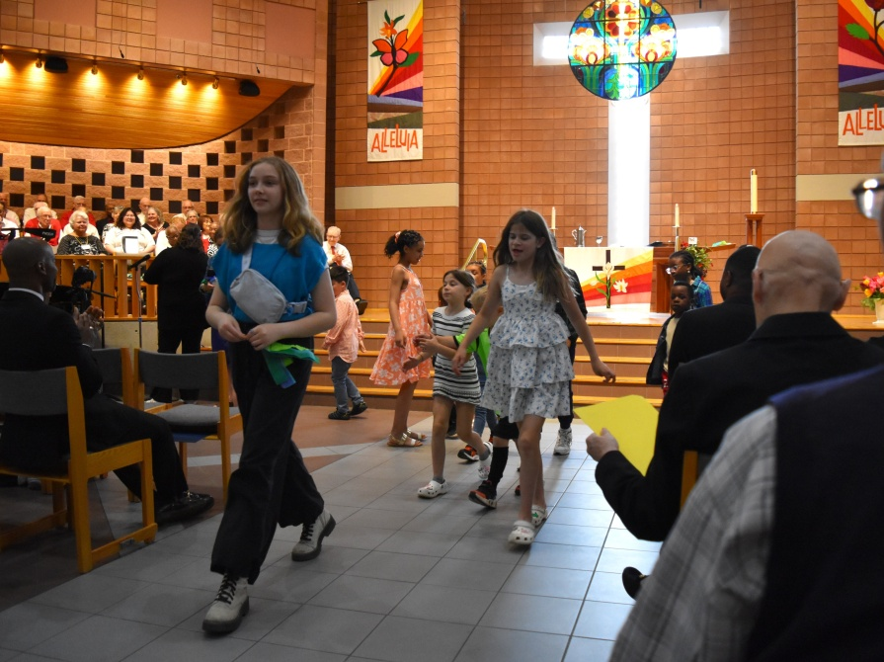
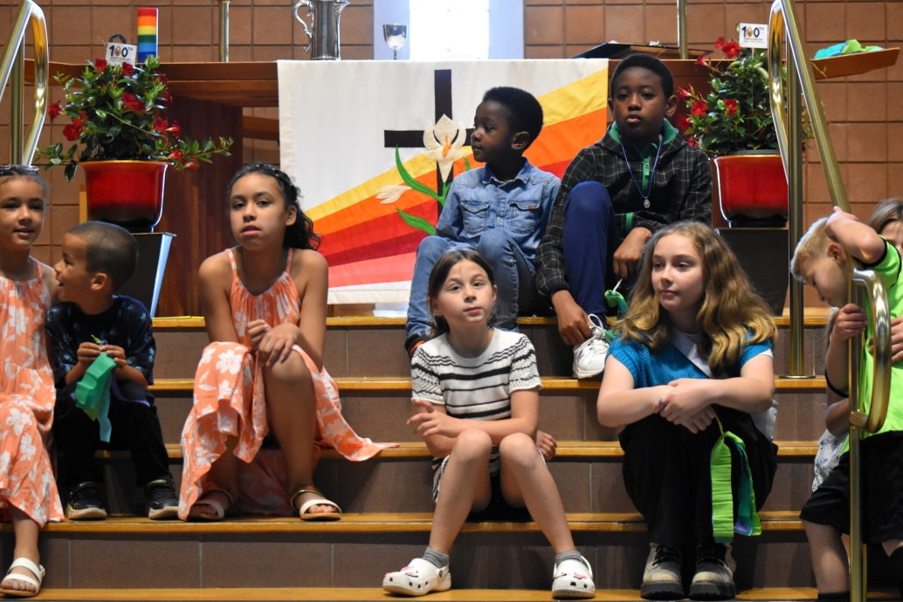
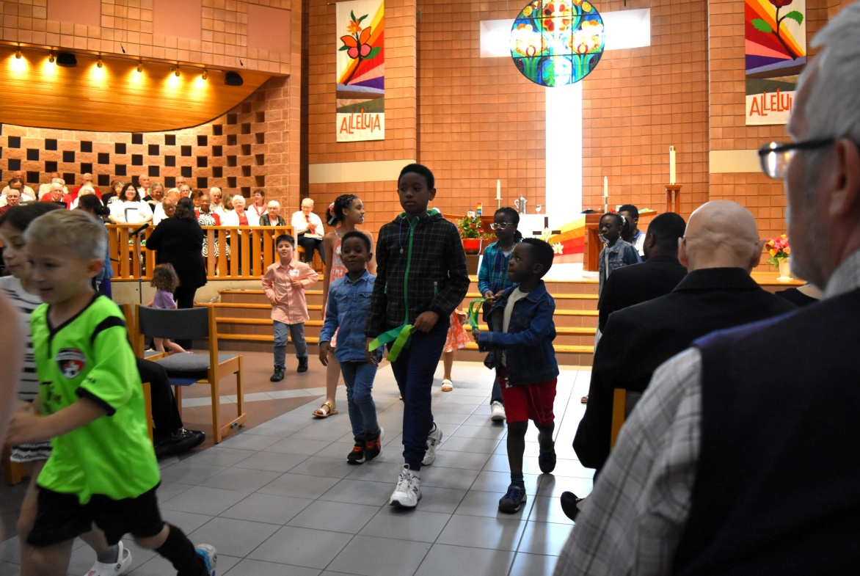
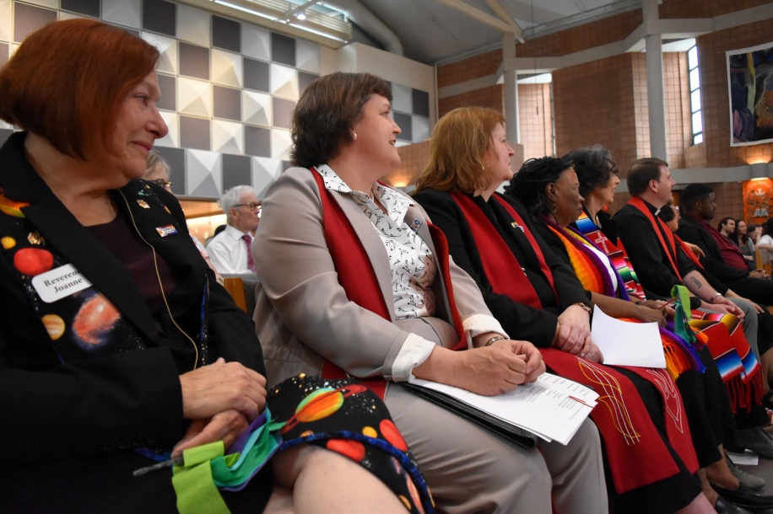
Time for All Ages ~ Victoria Keane & Youth

Slide 12
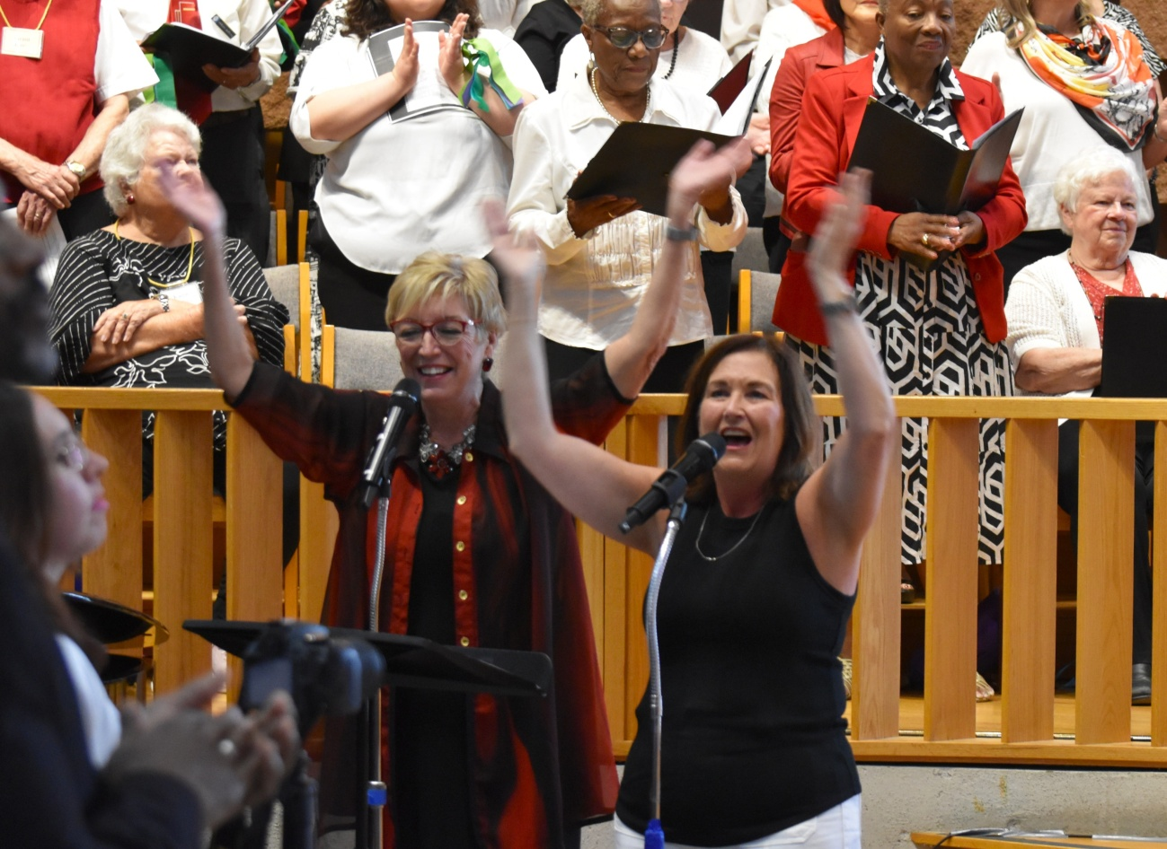
Contemporary Song ~ “Child of Love” Prayer of Illumination ~ Rev Weaver-Orosz

Slide 13
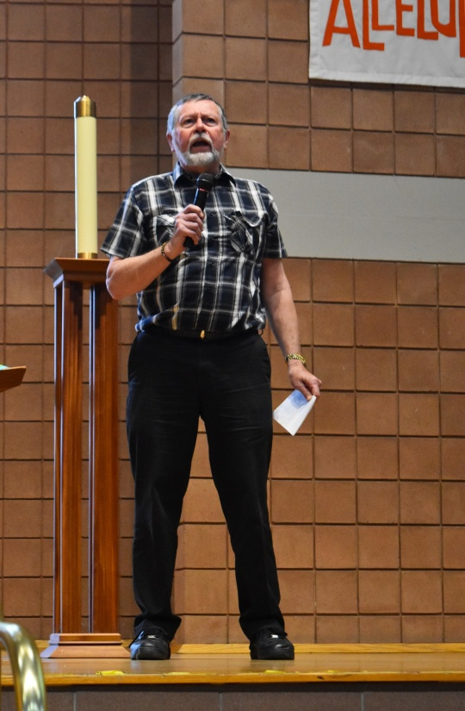
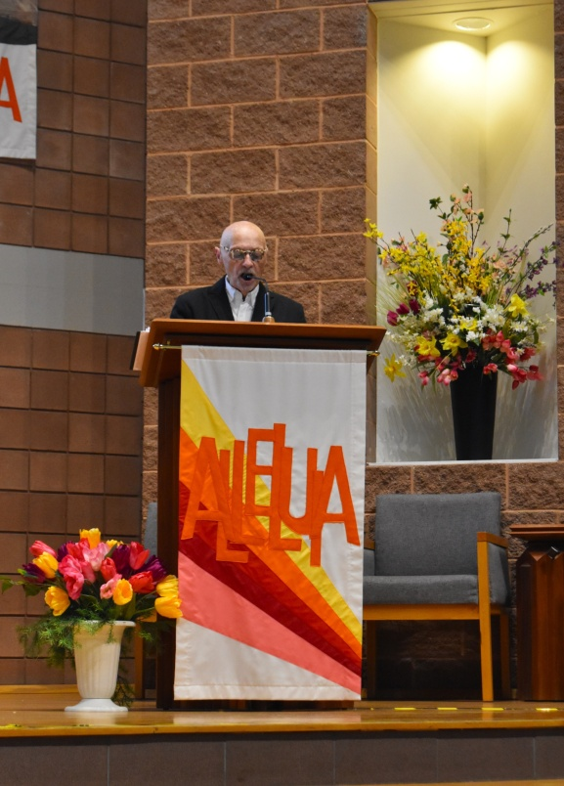
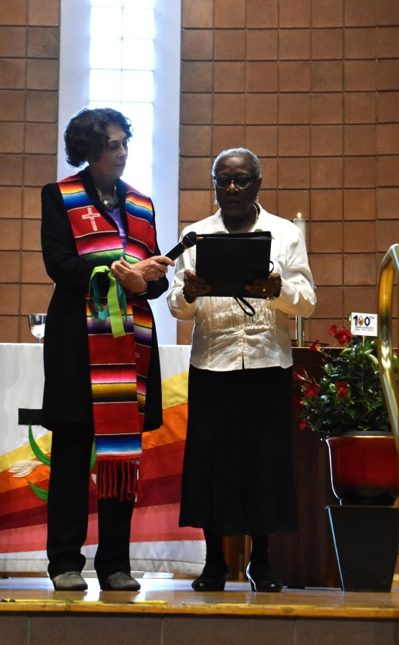
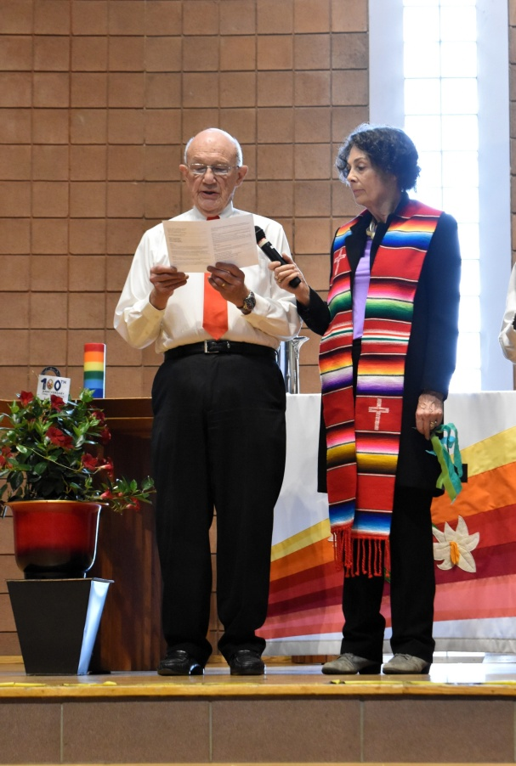
Sermon Reflections

Slide 14
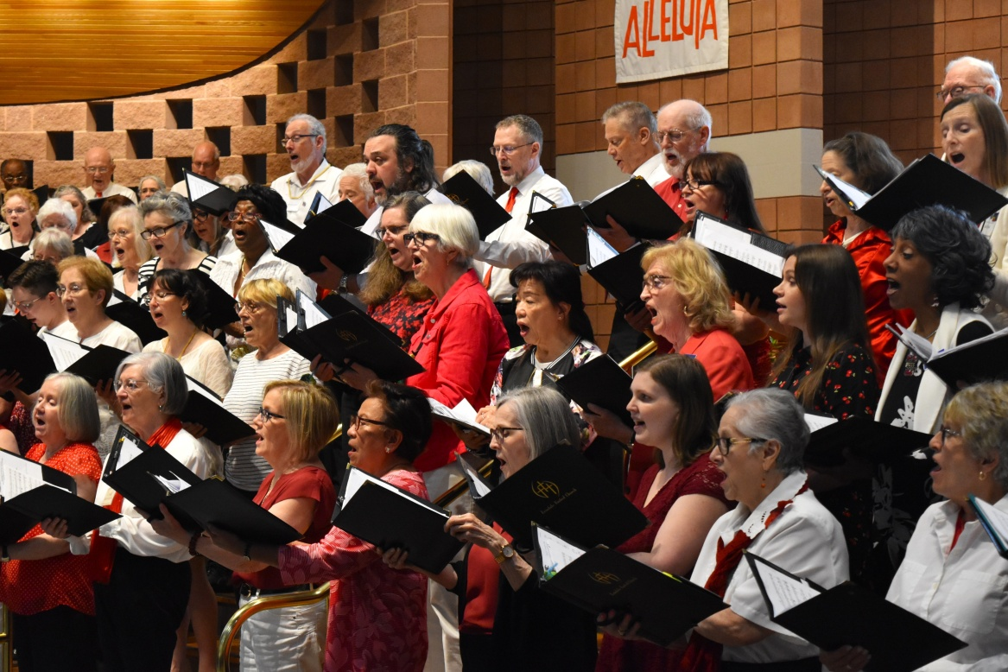
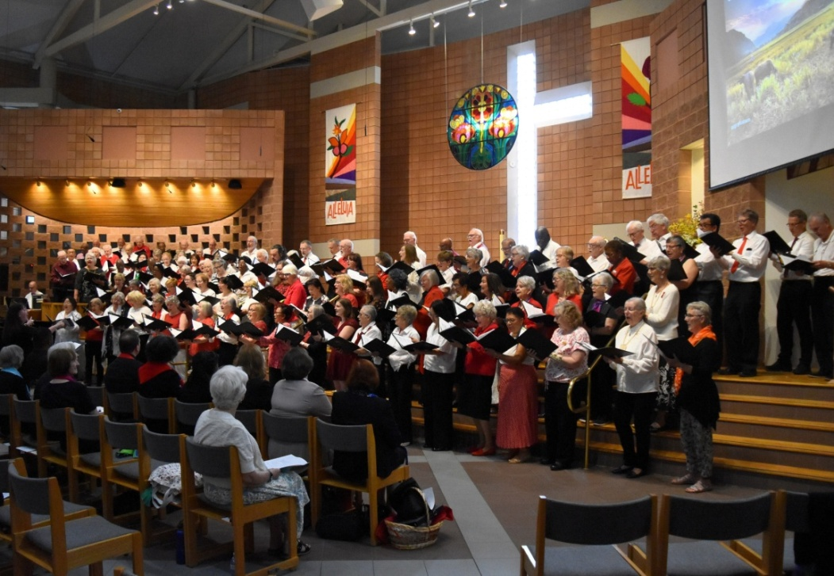
Combined Choir Anthem ~ “Spirit’s Comin’”

Slide 15
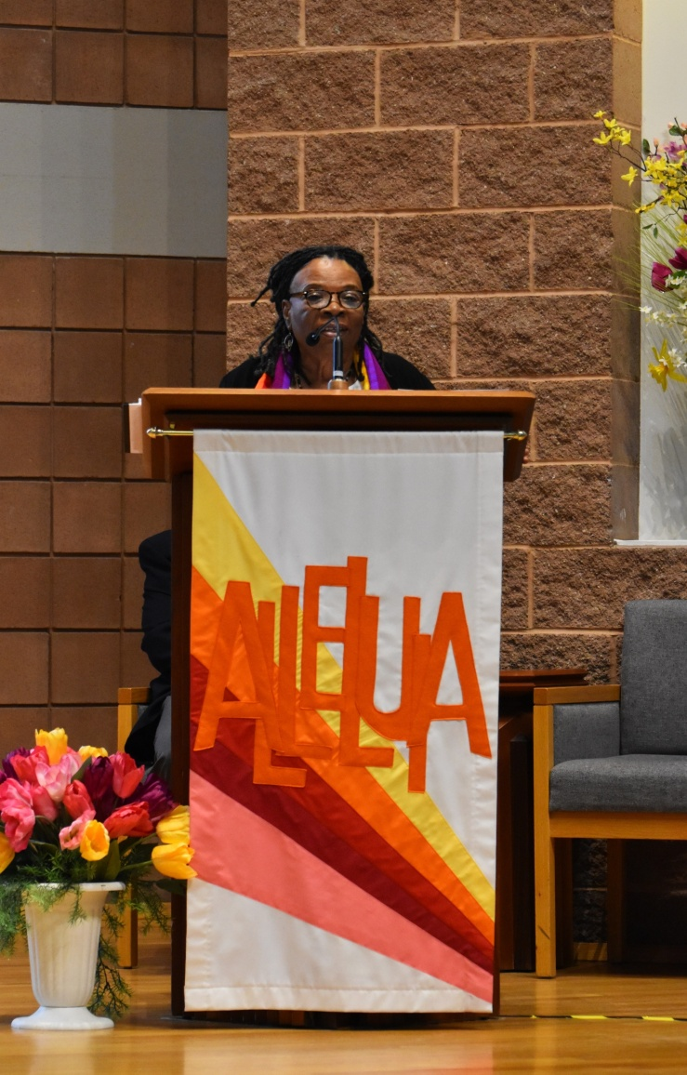
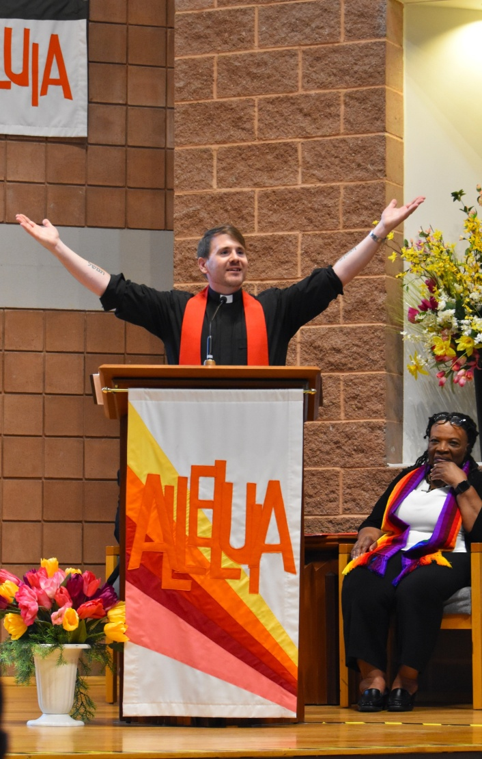
Sermon Reflections ~ Revs Norm Hennig-Pereria, Eleanor Scarlett & Joe Hopkins

Slide 16
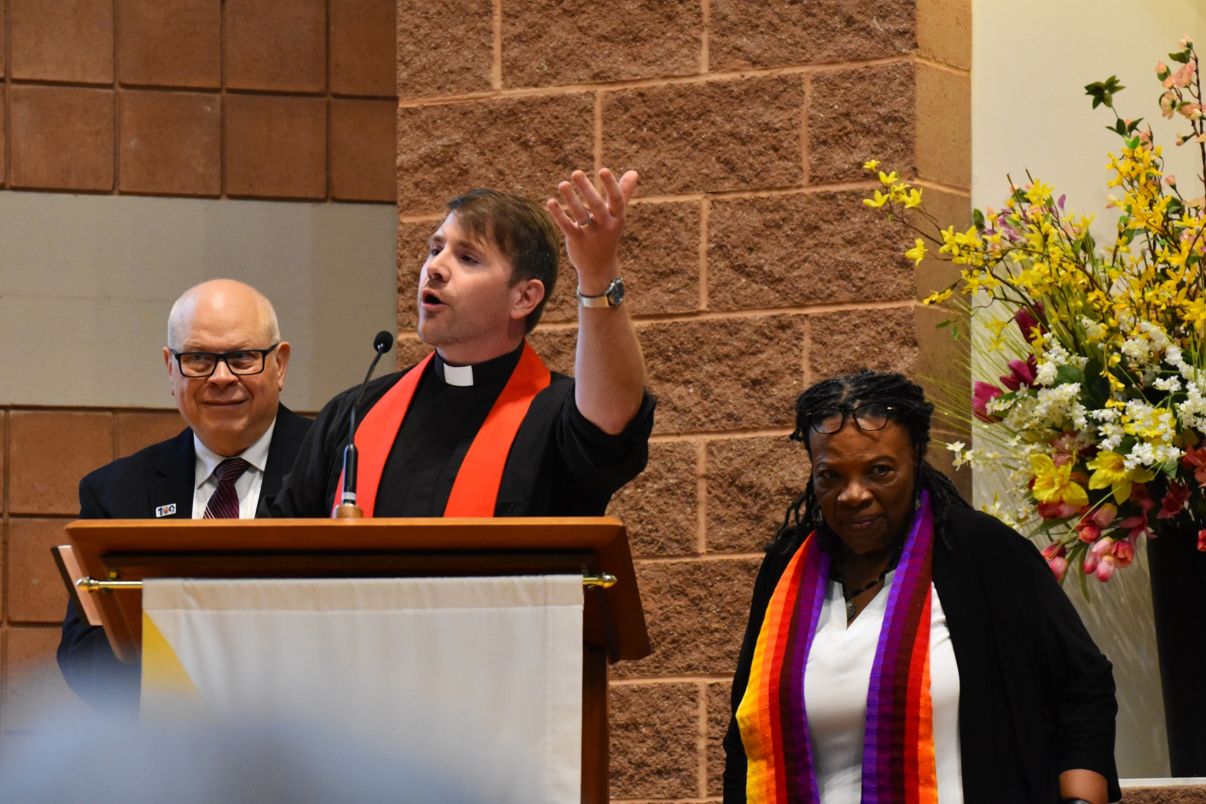

Slide 17
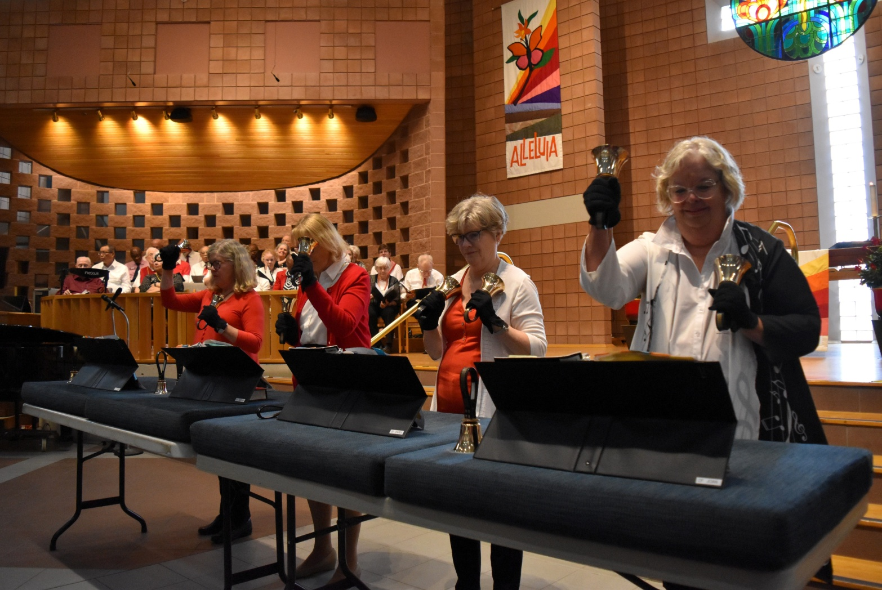
Invitation to the Offering ~ Rev Irene Ty & Bel Canto ~ “Ring in Triumph”

Slide 18
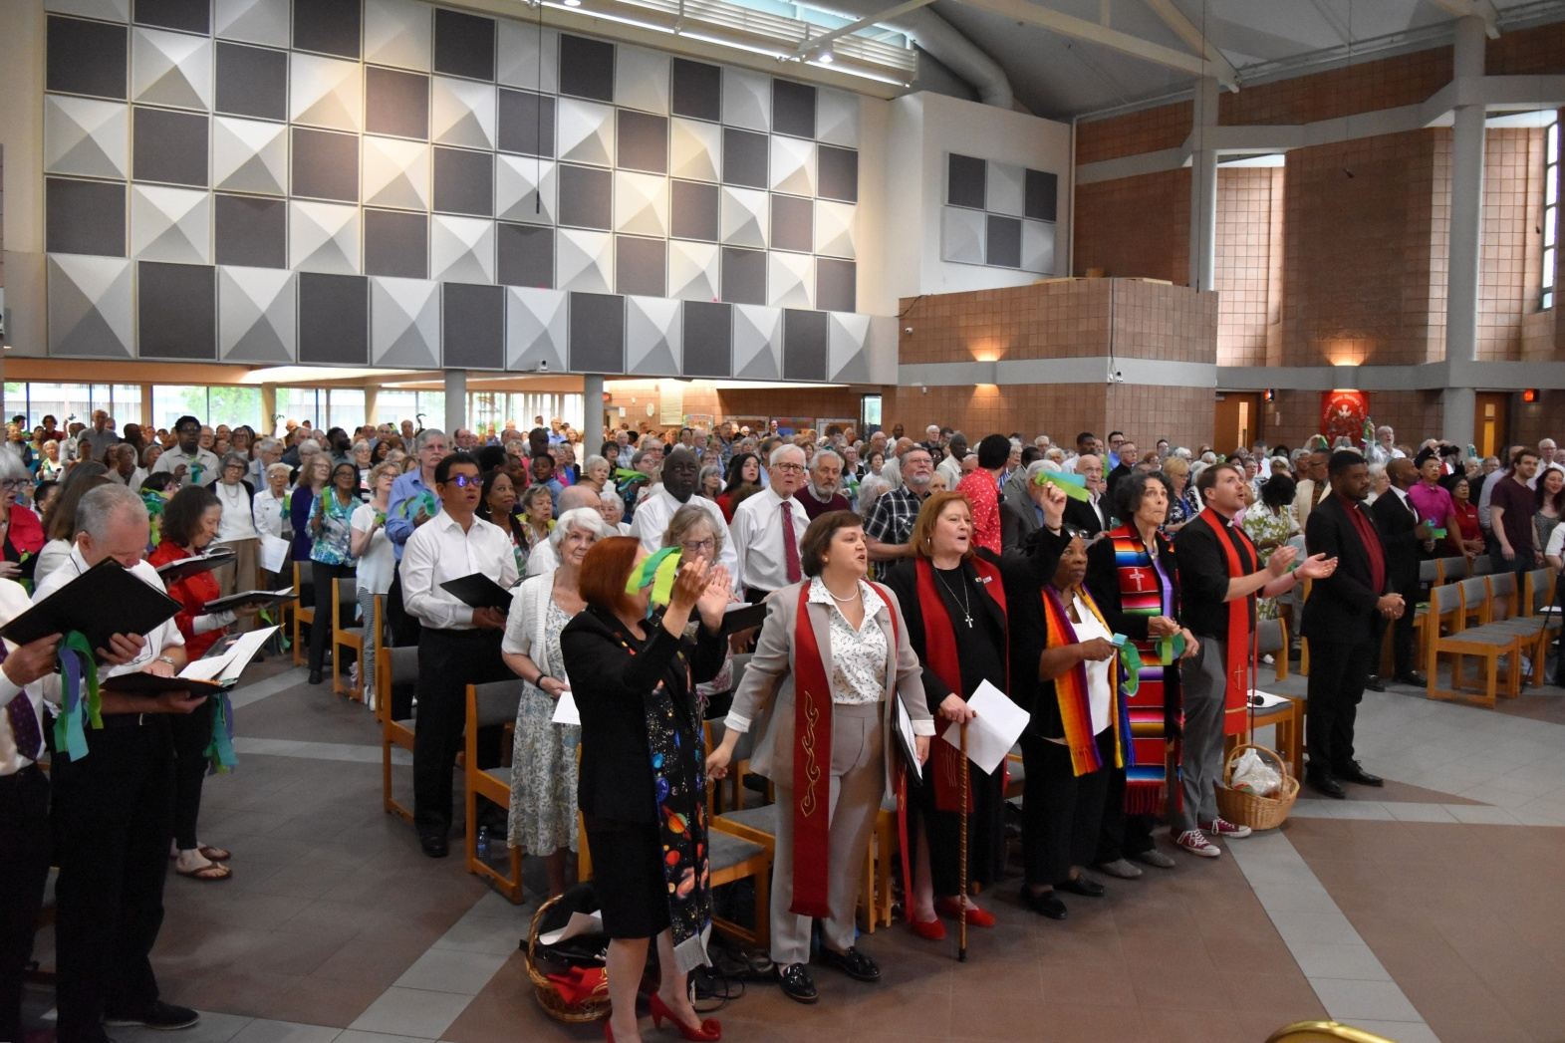
Offertory Response “What Can I Say?” & Prayer of Dedication ~ Irene Ty

Slide 19
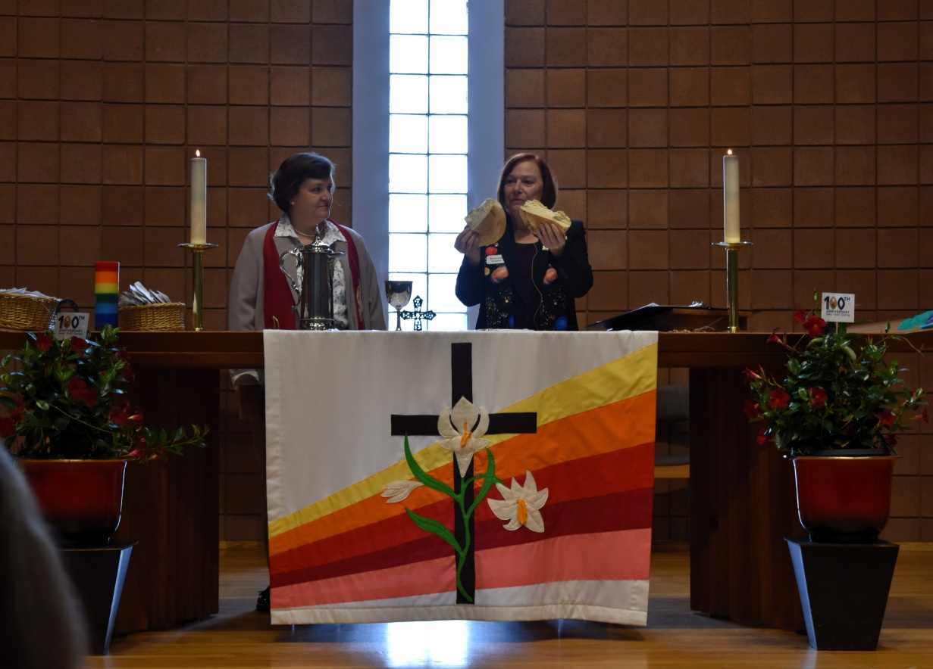
Sacrament of Communion ~ Rev Heather Weaver-Orosz & Rev Joanne Hedge

Slide 20
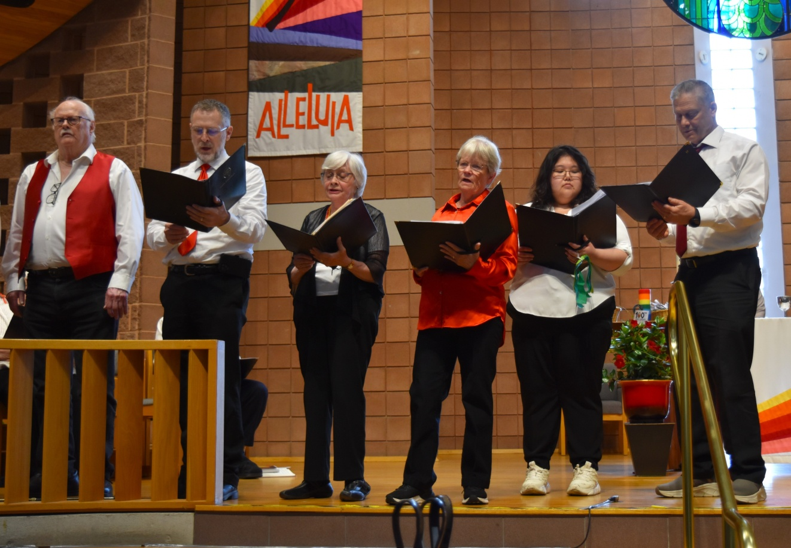
Singing the Prayer of Jesus ~ Caribbean Lord’s Prayer

Slide 21
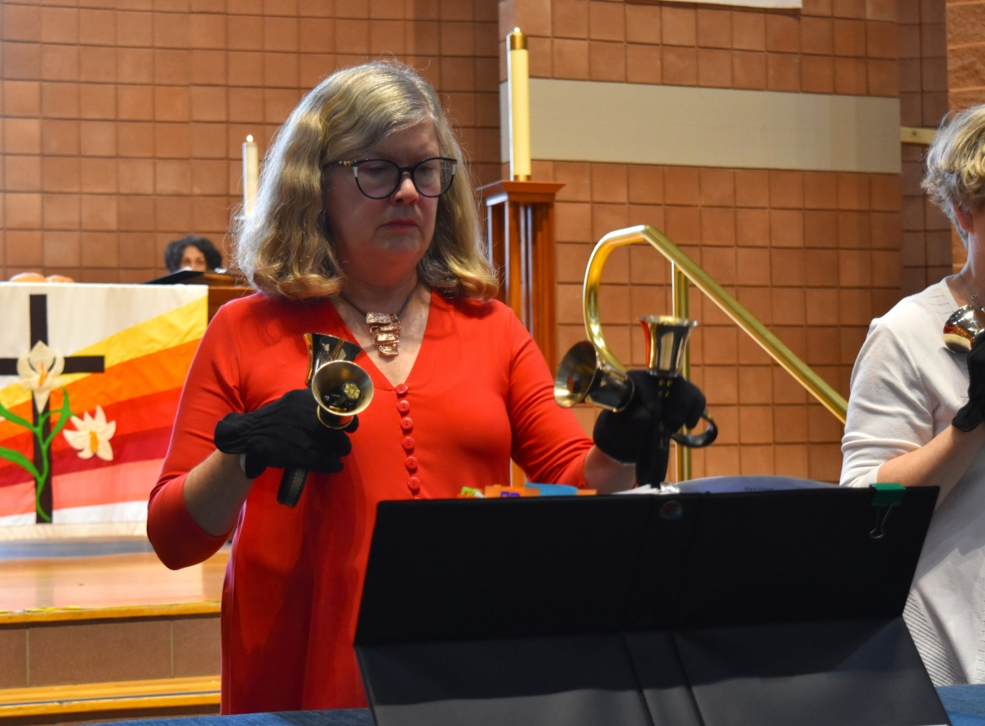
Bel Canto ~ “Celtic Farewell”

Slide 22
Prayer of Communion ~ Rev Morar Murray-Hayes & Celebrating 50 years of Ministry

Slide 23
Prayer for the Church ~ Walter Reid, Cheryl Henry & Brian Takayesu

Slide 24
A New Creed ~ read in Cantonese by Swing Chan of Mississauga Chinese United Church

Slide 25
Closing Hymn ~ “You Shall Go Out with Joy”

Slide 26
Blessing & Sending Forth ~ Rev Joanne Hedge & the people said: “Amen!”

Slide 27
Thank you to all of the following:
Joanne Hedge – the event was her inspiration
The organizers from 9 of the UC’s in Mississauga
Power point creators
Colourful pom-pom creators
Set designers & crew for set up & take down
The musicians, two EUC vocalists, the choirs, the bell choir, the liturgical dancers, the many participants – ministers, lay ministers, youth minister & children, offering collectors, all congregants, all volunteers – greeters, bulletin & hymnal distributors, AV crew
videographers, photographers
The hosts – Eden United Church
All the bakers & candle stick makers…

